Slide 1
BONES AND BONE TISSUES
BY MASAN, E

Slide 2
Introduction
One of the most remarkable tissues of the human body
Far from inert and lifeless, bones are living, dynamic structures
Bones serve a wide variety of very diverse functions within us
Noted for their strength and resiliency during life, bones will remain after we are long gone

Slide 3
SKELETAL CARTILAGES

Slide 4
Skeletal Cartilages
Initially our skeleton is made up of cartilages and fibrous membranes
Gradually our skeletal cartilages are replaced by bone
Upon reaching adulthood the skeleton becomes almost fully ossified
Only a few cartilages remain in the adult skeleton

Slide 5
Basic structure, type & location
A skeletal cartilage is made of some variety of cartilage tissue
Each type contains a high proportion of water which makes them resilient
Cartilage has no nerves or blood supply
It is surrounded by a dense tissue membrane called a perichondrium

Slide 6
Basic structure, type & location
There are three types of cartilage tissue: hyaline, elastic, and fibrocartilage
Each contains a matrix of jellylike ground substance and fibers

Slide 7
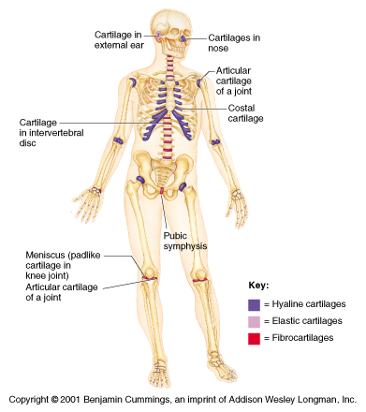
Cartilages

Slide 8
Hyaline cartilages
The most prevalent type of cartilage
Its high proportion of collagen fibers give it flexibility and resilience while providing support
Upon examination the tissue appears white, frosted, and smooth

Slide 9
Hyaline cartilage locations
Articular - covers the end of bones
Costal - connect ribs to breastbone
Laryngeal - skeleton of larynx
Tracheal & bronchial - reinforce the respiratory passages
Nasal - support the external nose

Slide 10
Elastic cartilage
Elastic cartilage is similar to hyaline cartilage but with more elastic fibers
Its elastic fibers enable it to withstand repeated bending
Found only in the external ear and the epiglottis

Slide 11
Fibrocartilage
The tissue contains parallel rows chondrocytes alternating with collagen fibers
Tissue is highly compressible and has great tensile strength
Found in thick pad-like structures like the menisci of the knee or the discs of the vertebral column

Slide 12
Growth of cartilage
Cartilage grows in two ways
Appositional growth occurs when cells in the surrounding perichondrium secrete new matrix next to existing cartilage tissue (growth from the outside)
Interstitial growth occurs when the chondrocytes within the cartilage divide and secrete new matrix, expanding the cartilage (growth from within)

Slide 13
FUNCTION OF BONES
SECTION II

Slide 14
Bones
Bones of the skeleton are organs that contain several different tissues
Bones are dominated by bone tissue but also contain
Nervous tissue and nerves
Blood tissue and vessels
Cartilage in articular cartilages
Epithelial tissue lining the blood vessels

Slide 15
Function of Bones:
Bones perform several important functions:
Support
Protection
Movement
Mineral storage
Blood cell formation

Slide 16
Function of Bones
Support
Bones provide a hard framework that supports the body
Bones provide support for internal organs

Slide 17
Function of Bone
Protection
Fused bones provide a brain case that protects this vital tissue
Spinal cord is surrounded by vertebrae
Rib cage protects vital organs

Slide 18
Function of Bone
Movement
Skeletal muscle attached to bones use the bones as levers to move the body
Arrangement of bones and joints determine the movements possible

Slide 19
Function of Bones
Mineral Storage
Bone serves as a mineral reservoir
Phosphate and calcium ions can be released into the blood steam for distribution
Deposition and removal are ongoing

Slide 20
Function of Bones
Blood cell formation
Hematopoiesis occurs within the marrow cavities of the long bones
The majority of hematopoiesis occurs in bones

Slide 21
CLASSIFICATION OF BONE

Slide 22
Classification of Bone:
Bones vary in shape and size
The unique shape of each bone fulfills a particular need
Bones are classified by their shape as long, short, flat, or irregular bone
Bones differ in the distribution of compact and spongy osseous tissues

Slide 23
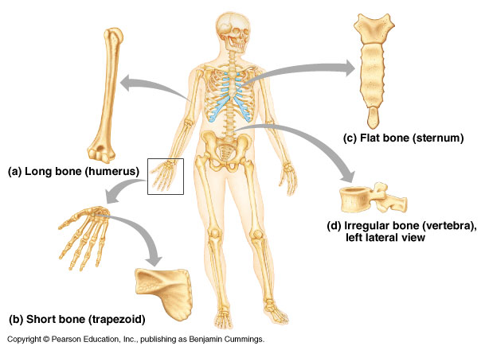
Classification of Bones

Slide 24
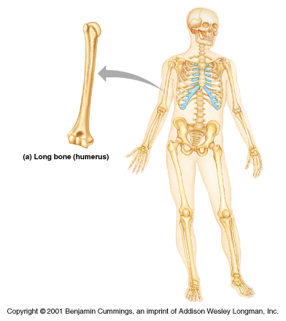
Classification: Long Bone
Long bones have a long shaft and two distinct ends
Classification is based on shape not size
Compact bone on exterior w/ spongy inner bone marrow

Slide 25
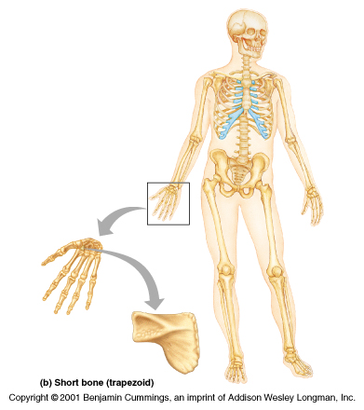
Classification: Short Bones
Short bones are roughly cubelike
Thin compact bone layer surrounding spongy bone mass
Short bones are often carpal, tarsal and sesamoid bones

Slide 26
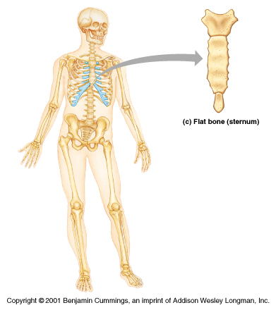
Classification: Flat Bones
Flat bones are thin, flattened and usually curved
Parallel layer of compact bone with spongy bone layer between
Skull, sternum and ribs are examples

Slide 27
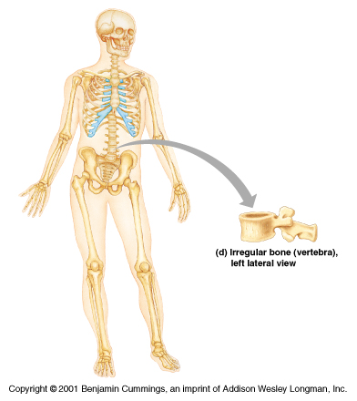
Classification: Irregular Bone
Irregular bones don’t fit into the previous categories
Complicated shapes
Consist of spongy bone with a thin layer of compact
Examples are hip bones & vertabrae

Slide 28
Sesamoid bones develop in certain tendons where there is considerable friction, tension, and physical stress, such as the palms and soles.
They may vary in number from person to person, are not always completely ossified, and typically measure only a few millimeters in diameter.

Slide 29
Notable exceptions are the two patellae (kneecaps), large sesamoid bones located in the quadriceps femoris tendon
Functionally, sesamoid bones protect tendons from excessive wear and tear, and they often change the direction of pull of a tendon, which improves the mechanical advantage at a joint.

Slide 31
BONE STRUCTURE
SECTION IV

Slide 33
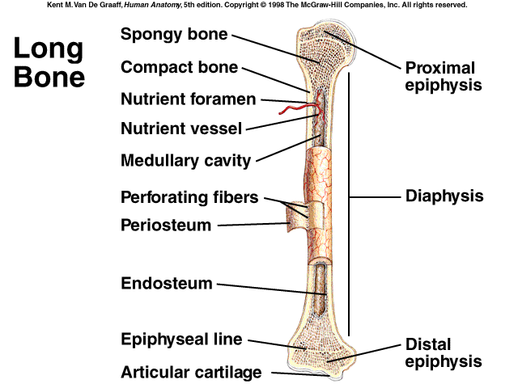
Gross Anatomy
Landmarks on a typical long bone
Diaphysis
Epiphysis
Membranes
Membranes
Periosteum
Endosteum

Slide 34
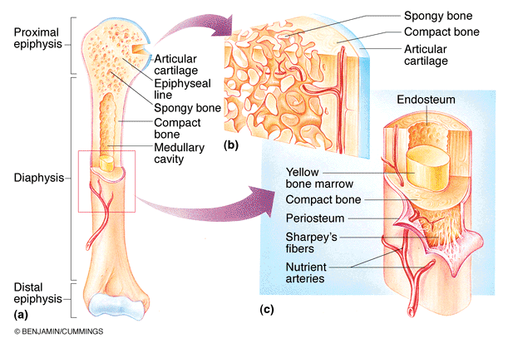
Diaphysis
Long tubular diaphysis is the shaft of the bone
Collar of compact bone surrounds a central medullary or marrow cavity
In adults, cavity contains fat

Slide 35
Epiphysis
The epiphyses are the ends of the bone
The joint surface of the epiphysis is covered with articular cartilage
Epiphyseal line separate diaphysis and epiphysis

Slide 36
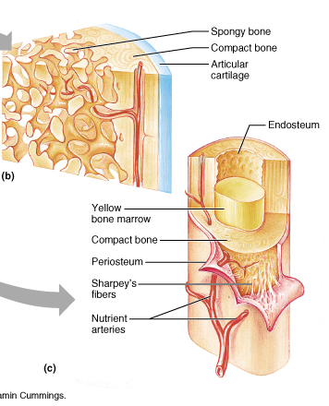
Blood Vessels
Unlike cartilage bone is well vascularized
Nutrient arteries serve the diaphysis
The nutrient artery runs inward to supply the bone marrow and the spongy bony

Slide 37
Medullary cavity
The interior of all bones consists largely of spongy bone
The very center of the bone is an open cavity or marrow cavity
The cavity is filled with yellow bone marrow

Slide 38
Membranes
Periosteum covers outer bone surface
Consists of dense irregular connective tissue & osteoblasts
Contain nerve fiber blood and lymph vessels secured by Sharpey’s fibers
Endosteum covers internal bone surfaces

Slide 39
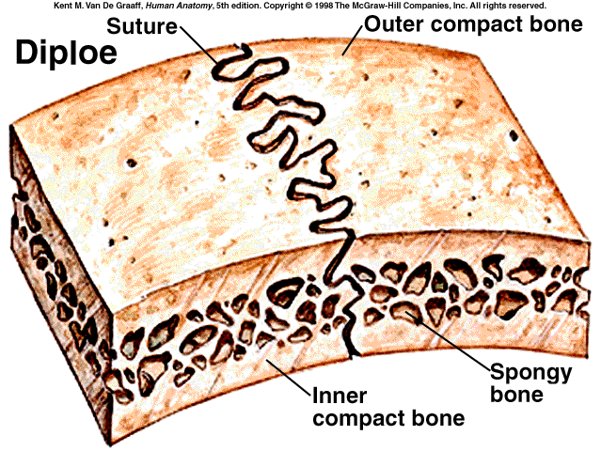
Short, Irregular and Flat Bones
Bones consist of thin layers of compact bones over spongy bone
No shaft, epiphysis or marrow cavity
Spongy area between is called a diploe
Flat sandwich of bone

Slide 40
Hematopoietic Tissue
The hematopoietic tissue, red marrow, is typically found within the cavities of spongy bone of long bones and in the diploe of flat bones
These cavities are referred to as red marrow cavities
In infants the medullary cavity and all areas of spongy bone contain red bone marrow

Slide 41
Hematopoietic Tissue (con’t)
In the adult the medullary cavity contains fat that extends into the epiphysis and there is little red marrow present in spongy bone cavities
Blood cell production occurs only in the head of the femur and humerous
Most blood cell production occurs in the diploe areas of the sternum and hip
Yellow marrow can revert to red marrow if the person becomes very anemic

Slide 42
Compact Bone
Compact bone appears very dense
It actually contains canals and passageways that provide access for nerves, blood vessels, and lymphatic ducts
The structural unit of compact bone is the osteon or Haversian system
Each osteon is an elongated cylinder running parallel to the long axis of the bone
Structurally each osteon represents a weight bearing pillar

Slide 43
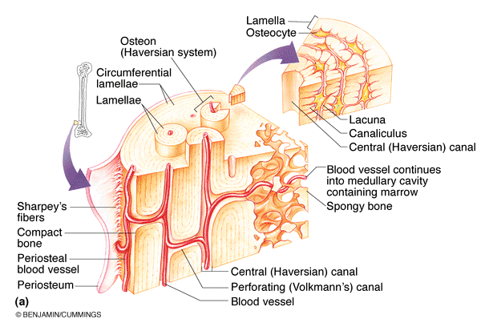
Compact bone

Slide 44
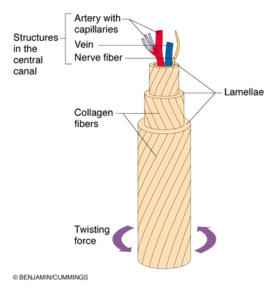
An Osteon
Each osteon is a group of hollow tubes of bone matrix
Each matrix tube is a lamella
Collagen fibers in each layer run in opposite directions
Resists torsion stresses

Slide 45
An Osteon
Running through the core of each osteon is the central or Haversian canal
The canal contains small blood vessels that supply the cells of the osteon

Slide 46
Perforating (Volkmann’s) Canal
Canals lie at right angles to long axis of bone
Connect the vascular supply of the periosteum to those of the central canal and medullary cavity

Slide 47
Compact Bone
Osteocytes occupy small cavities or lacunae at the junctions of lamellae
Fine canals called canaliculi connect the lacunae to each other and to the central canal
Canaliculi tie all the osteocytes in an osteon together

Slide 48
Spongy Bone
Consisting of trabeculae
Trabeculae align along lines of stress
Function as struts of bone
Trabeculae contain irregularly arranged lamallae and osteo-cytes interconnected by canaliculi
No osteons present

Slide 49
Cells of Bone
Osteoblasts – bone-forming cells
Osteocytes – mature bone cells
Osteoclasts – large cells that resorb or break down bone matrix

Slide 50
Chemical Composition of Bone: Organic
Osteoid – unmineralized bone matrix composed of proteoglycans, glycoproteins, and collagen
Osteoid makes up 1/3 of the matrix
These components, particularly collagen contribute to the flexibility and tensile strength of bone to resist stretching and twisting

Slide 51
Chemical Composition of Bone: Inorganic
Hydroxyapatites, or mineral salts
Sixty-five percent of bone by mass
Mainly calcium phosphates
Tiny crystals of calcium salts are deposited in and around the collagen fibers of the extracellular matrix
The crystals are exceptionally hard and resist compression
Responsible for bone hardness and its resistance to compression

Slide 52
Bone Markings
Bones are shaped by the tissues that act upon and around them
Bones display bulges, depressions and holes which serve as sites of muscle, ligament and tendon attachment, points of articulation, or as conduits for blood vessels and nerves
Projections from the bone surface include heads, trochanters, spines, and others
Depressions include fossae, sinuses, foramina, and grooves

Slide 53
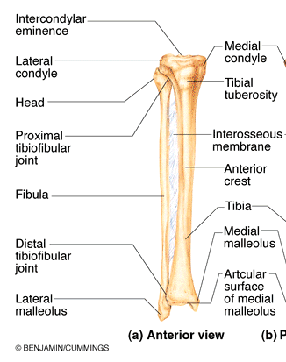
Bone Markings
Tuberosity - a large rounded projection which may be roughened
tibial tuberosity

Slide 54
Bone Markings
Crest - A narrow ridge of bone; usually prominent
Crest of the ilium

Slide 55
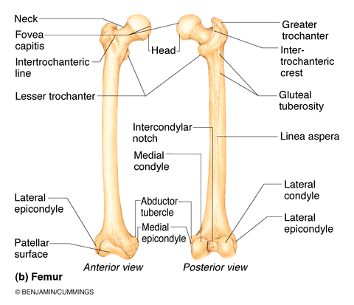
Bone Markings
Trochanter - A very large, blunt, irregularly shaped process
Greater trochanter of femur

Slide 56
Bone Markings
Line - Narrow ridge of bone; less prominent than a crest
Intertrochanteric line

Slide 57
Bone Markings
Tubercle - Small rounded projection or process
adductor tubercle

Slide 58
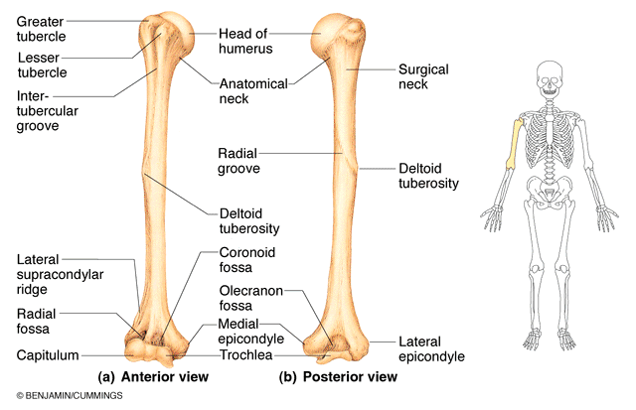
Bone Markings
Epicondyle - raised area on or above a condyle
medial epicondyle of the humerous

Slide 59
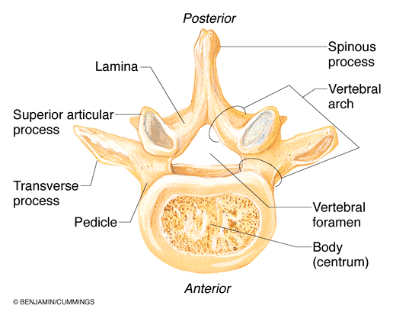
Bone Markings
Spine - A sharp, slender, often pointed projection
Spinous process of vertebrae

Slide 60
Bone Markings
Head - Bony expansion carried on a narrow neck
head of the humerus

Slide 61
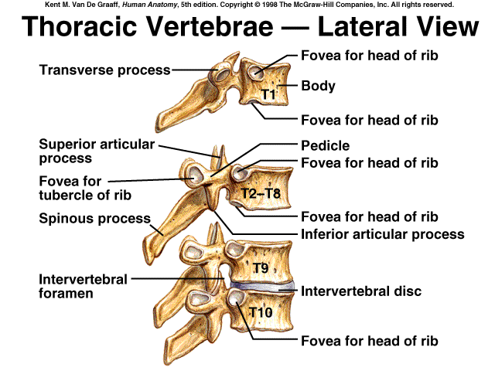
Bone Markings
Facet - Smooth, nearly flat articular surface
facet on transverse process of thoracic vertebrae
Facet

Slide 62
Bone Markings
Condyle - Rounded articular projection
lateral condyle of femur

Slide 63
Bone Markings
Ramus - Armlike bar of bone
ramus of the pubis

Slide 64
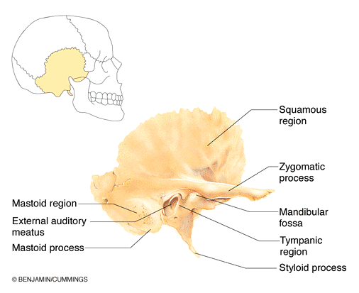
Bone Markings
Meatus - canal-like passageway
External auditory meatus

Slide 65
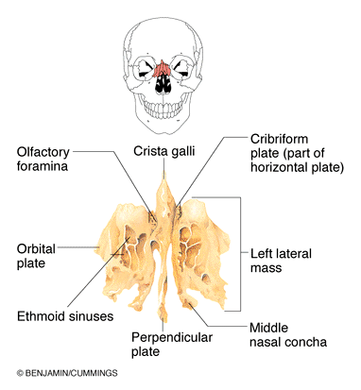
Bone Markings
Sinus - Cavity within a bone, filled with air and lined with mucous membrane
nasal sinus

Slide 66
Bone Markings
Fossa - Shallow, basinlike depression in a bone often serving as an articular surface
Olecranon fossa

Slide 67
Bone Markings
Groove - a narrow furrow in the surface of the bone
radial groove

Slide 68
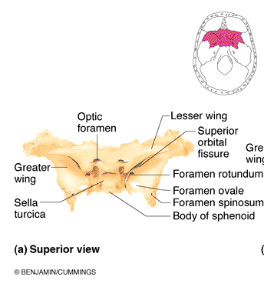
Bone Markings
Fissure - Narrow, slitlike opening

Slide 69
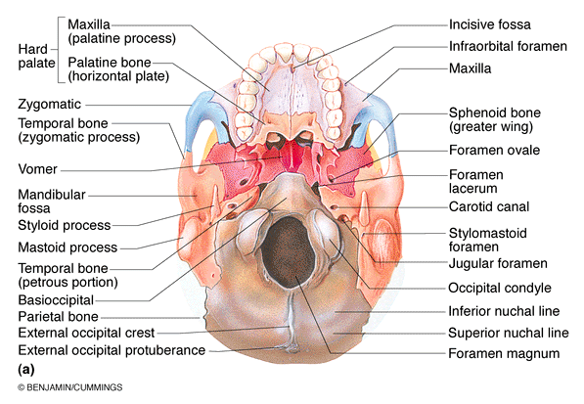
Bone Markings
Foramen - Round or oval opeing through a bone
Foramen magnum

Slide 70
Bone Development
Osteogenesis and ossification refer to the process of bone formation
In the developing embryo the process leads to the formation of the bony skeleton
Bone growth continues until adulthood as the individual increases in size
Remodeling is bone resorption and deposition in response to stress and repair of bone

Slide 71
Developmental Aspects of Bones
Mesoderm gives rise to embryonic mesenchymal cells, which produce membranes and cartilages that form the embryonic skeleton
The embryonic skeleton ossifies in a predictable timetable that allows fetal age to be easily determined from sonograms
At birth, most long bones are well ossified (except for their epiphyses)

Slide 72
Formation of the Bony Skeleton
The human embryo at 6 weeks is made entirely from fibrous membranes and hyaline cartilage
At 6 weeks bone begins to develop and eventually replaces most of the existing fibrous or cartilage structures
The process of one developing from a fibrous membrane is called intra-membranous ossification
The bone is called a membrane bone

Slide 73
Formation of the Bony Skeleton
Bone formation that occurs by replacing hyaline cartilage structures is called endochondral ossification
A bone formed in this manner is called a endochondral bone

Slide 74
Intramembranous Ossification
Intramembranous ossification results in the formation of most bones of the skull and the clavicles
Notice that these are flat bones
Fibrous connective tissue membranes formed by mesenchymal cells serve as the initial supporting structures on which ossification begins at the eighth week of development

Slide 75
Intramembranous Ossification
Formation of an ossification center in the fibrous membrane
Centrally located mesenchymal cells cluster and differentiate into osteoblasts, forming the ossification center

Slide 76
Intramembranous Ossification
Formation of the bone matrix within the fibrous membrane
Osteoblasts begin to secrete osteoid; it is mineralized within a few days
Trapped osteoblasts become osteocytes

Slide 77
Intramembranous Ossification
Formation of the woven bone and the periosteum
Accumulating osteoid forms a network which encloses local blood vessels
Vascularized mesenchyme forms on the external face of woven bone to become periosteum

Slide 78
Intramembranous Ossification
Bone collar of compact bone forms
Trabeculae just deep to the periosteum thicken, forming a woven collar which is later replaced with mature lamellar bone
Spongy bone persists internally and its vascular tissue becomes red marrow

Slide 79
Endochondral Ossification
Most bones form by the process of endochondral ossification
Process begins late in the second month of development
Process uses hyaline cartilage “bones” as the pattern for bone construction
During this process cartilage is broken down as ossification proceeds

Slide 80
Endochondral Ossification
The formation of long bone typically begins at the primary ossification center of the hyaline cartilage shaft
The perichondrium (fibrous connective tissue layer) becomes infiltrated by blood vessels converting it to vascularized periosteum
The increase in nutrition enables the mesenchyme cells to differentiate into osteoblast cells

Slide 81
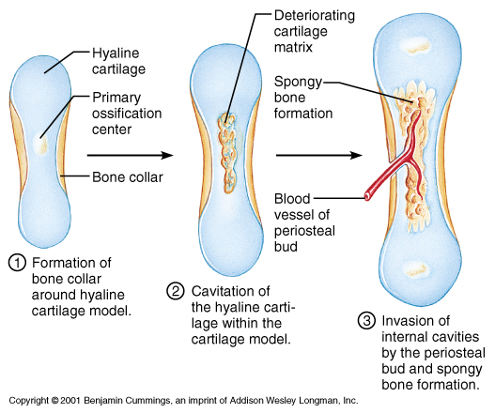
Endochondral Ossification
Formation of a bone collar around hyaline cartilage model
Osteoblasts of the new periosteum secrete osteoid against the hyaline cartilage along the diaphysis

Slide 82
Endochondral Ossification
Cartilage in the center of the diaphysis calcifies
Calcification of cartilage blocks nutrients and chondrocytes die
Matrix deteriorates and cavities develop
Bones stabilized by collar; growth occurs at epiphysis

Slide 83
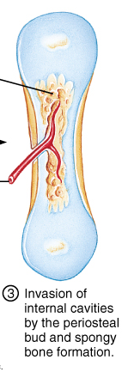
Endochondral Ossification
Invasion of the internal cavities by the periosteal bud and spongy bone
Bud contains nutrient artery & vein, lymphatics, nerve fibers, red marrow elements, osteoblasts and osteoclasts
Spongy bone forms

Slide 84
Endochondral Ossification
Formation of the medullary cavity as ossification continues
Secondary ossification centers form in epiphyses
Cartilage in epiphyses calcifies and deteriorates opening cavities for entry of periosteal bud

Slide 85
Endochondral Ossification
Ossification of the epiphyses
Hyaline cartilage remains only at epiphyseal plates
Epiphyseal plates promote growth along long axis
Ossification chases cartilage formation along length of shaft

Slide 86
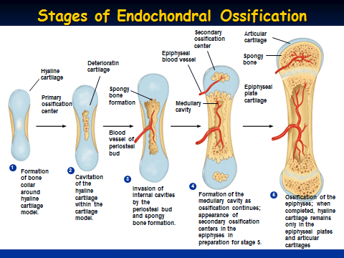

Slide 87
Postnatal Bone Growth
During infancy and youth bone growth occurs entirely by interstitial growth of the epiphyseal plates
Bones grow in thickness by appositional growth
Bones stop growing during adolescence or in early adulthood
Some facial bones such as the nose or lower jaw continue to grow throughout life

Slide 88
Growth in Length of Long Bones
Process of longitudinal bone growth mimics the event of endochondral ossification

Slide 89
Long Bone Growth
Cells in the epiphyseal plate undergo rapid cell mitosis pushing epiphysis away from diaphysis
Older cells enlarge, matrix becomes calcified
Chondrocytes die and their matrix deteriorates
Calcified cartilage is covered by bone matrix secreted by osteoblasts to form spongy bone

Slide 90
Long Bone Growth and Remodeling
Long bone growth is accompanied by almost continuous remodeling in order to maintain proper proportions
Bone remodeling involves both bone formation and resorption
Remodeling can occur at differnet rates within different areas of the same bone, with the epiphysis being replaced every five to six months while the shaft is replaced more slowly

Slide 91
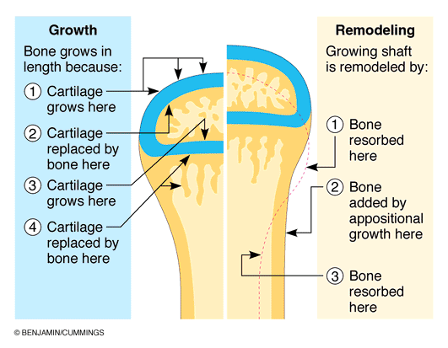
Growth and Remodeling

Slide 92
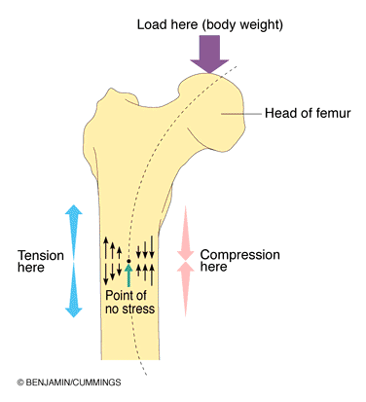
Bone Anatomy and Stress
Wolff’s law holds that a bone grows or remodels in response to the forces which act upon it
Changes in bone density in response to exercise
Tension and compression forces must balance

Slide 93
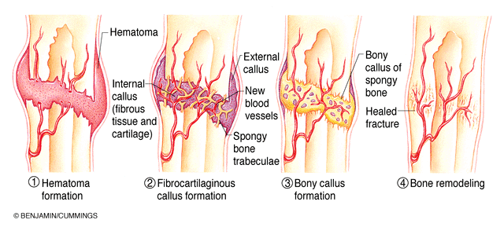
Healing of a Bone Fracture

